Slide 1
DB2 – FILE PROGRAM
DB2 Training class 06

Slide 2
DATA FLOW ( FILE 2 DB2 )
FILE
RECORD
LAYOUT
MOVE
WORKING
VARIABLES
READ
MOVE
MOVE
HOST
VARIABLES
INSERT
DB2

Slide 3
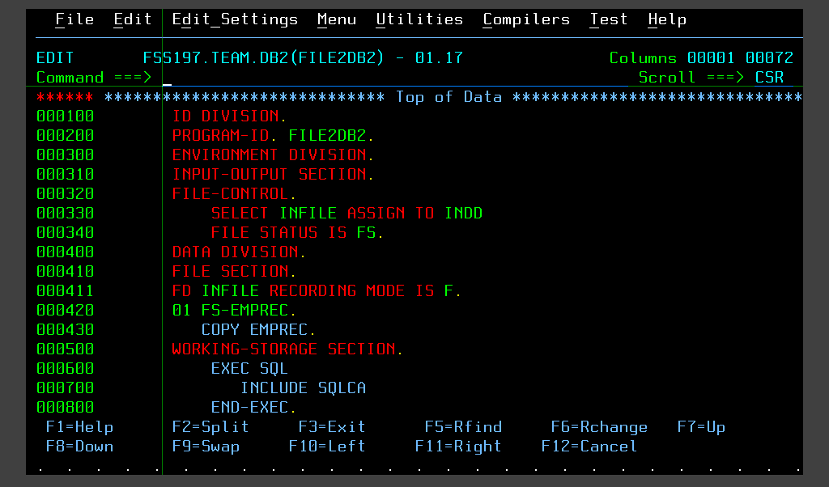

FILE 2 DB2 PROGRAM

Slide 4
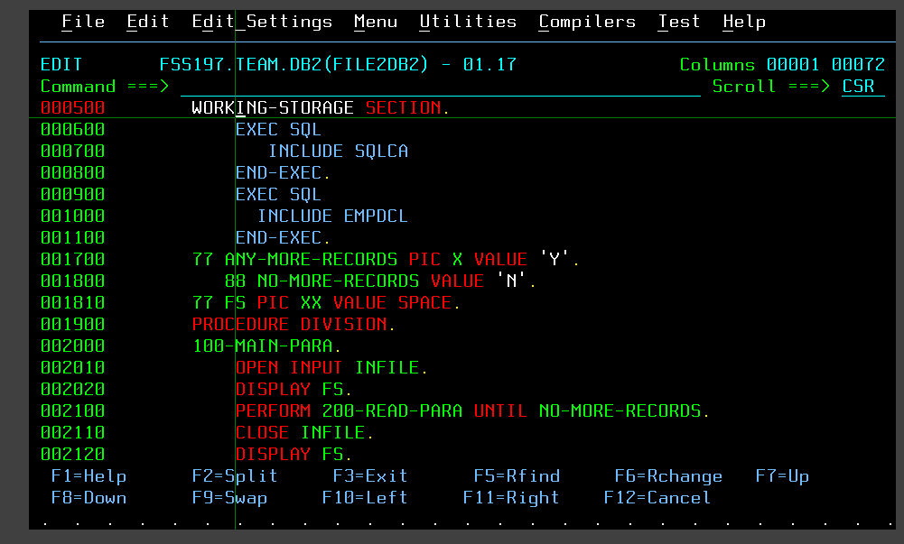
FILE 2 DB2 PROGRAM

Slide 5
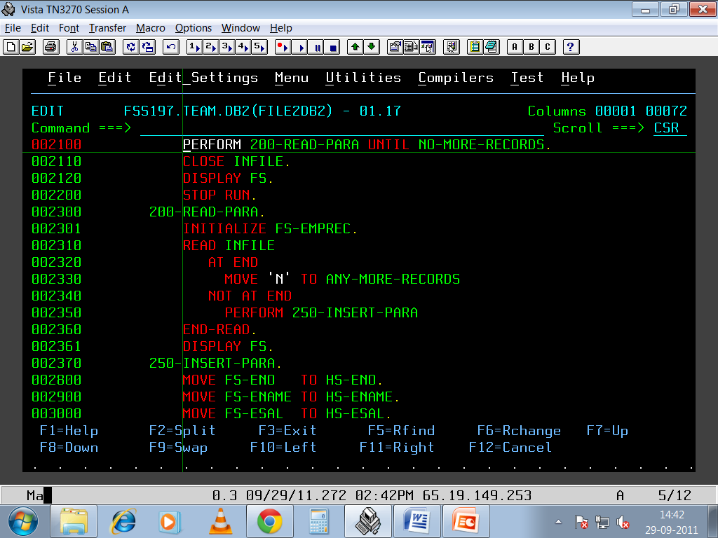
FILE 2 DB2 PROGRAM

Slide 6
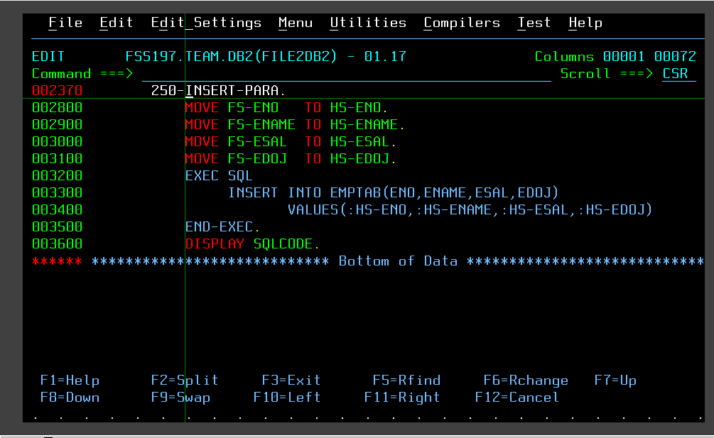
FILE 2 DB2 PROGRAM

Slide 7
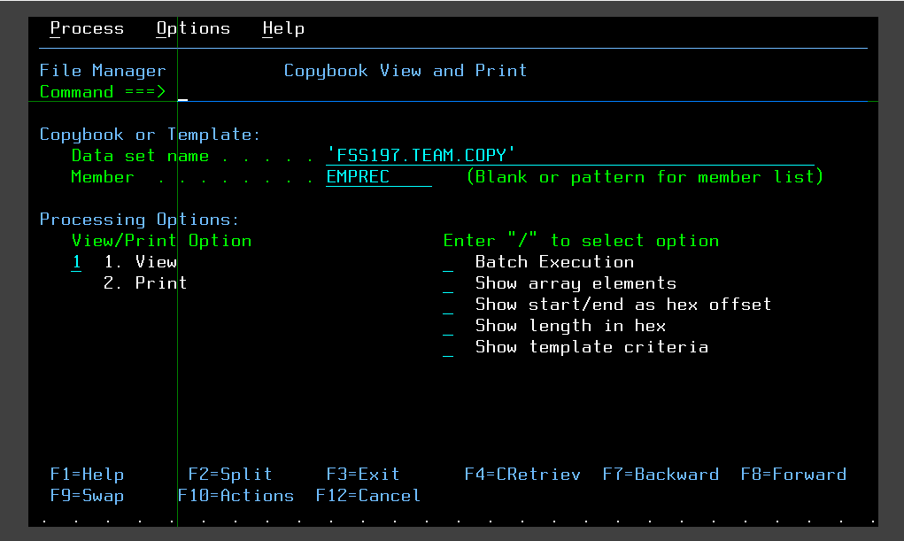
FILE-MANAGER 3.13 COPYBOOK VIEW

Slide 8
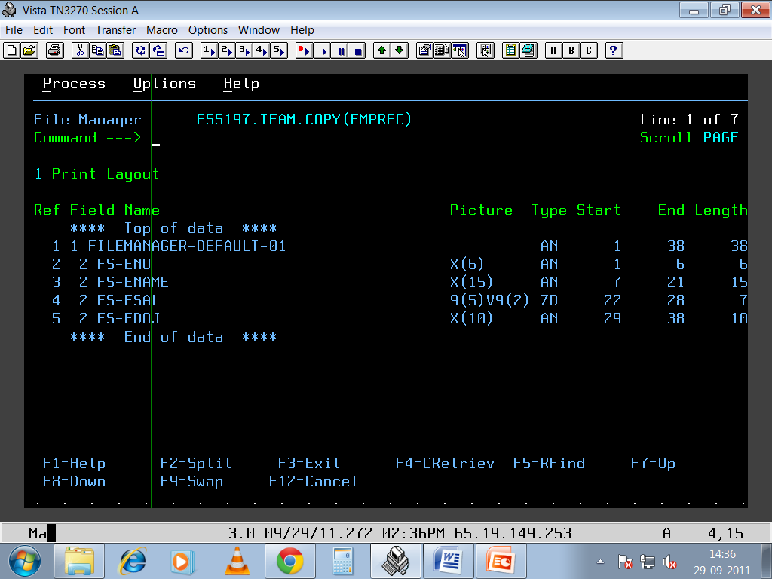
COPYBOOK VIEW

Slide 9
CURSOR

Slide 10
INTRODUCTION TO CURSOR
If a program issues a SELECT …INTO statement and retrieve several rows all at once then this would result in an error. ( -811 )
DB2 has a mechanism, called a cursor, that enables an application to retrieve a set of rows and then process the set, one row at a time.
By using cursor, the program can retrieve each row sequentially from the results table until end-of-data
(i.e. Until SQLCODE=100).

Slide 11
DATA FLOW ( DB2 2 FILE )
DB2
CURSOR
MOVE
HOST
VARIABLES
WORKING
VARIABLES
SELECT
MOVE
MOVE
RECORD
LAYOUT
WRITE
FILE

Slide 12
Scrollable And Non-scrollable Cursors
A non-scrollable cursor always moves sequentially forward in the result table.
To make a cursor scrollable, you declare it as scrollable
  EXEC SQL
  DECLARE CUR_NAME SENSITIVE/IN SENSITIVE DYNAMIC/STATIC SCROLL CURSOR FOR
  SELECT DEPTNO, DEPTNAME, MGRNO FROM DSN8810.DEPT ORDER BY DEPTNO
  END-EXEC.

Slide 13
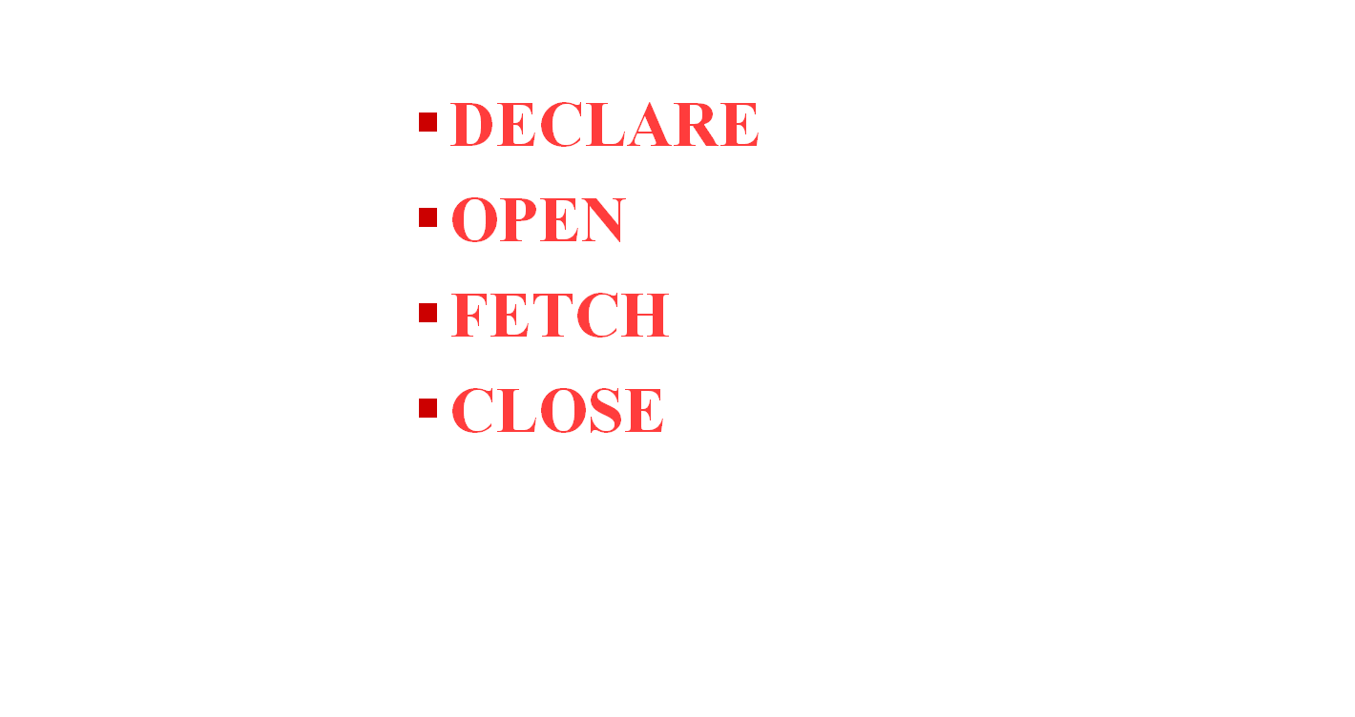
The Four Cursor Control Statement

Slide 14
DECLARE Statement
This statement names a cursor and specifies a SELECT statement. The SELECT statement defines a set of rows that make up the results table.
EXEC SQL
DECLARE cursor-name CURSOR [ WITH HOLD ]
FOR SELECT column1, column2, ..
FROM table-name
WHERE condition
FOR UPDATE OF column, ...
FOR FETCH ONLY
END-EXEC.

Slide 15
FETCH / UPDATE
The FOR UPDATE OF Clause
This clause must be specified if you intend to update any (or all) of the rows in the identified table.
The FOR FETCH ONLY Clause
It is used to indicate that there is no intention to update the table. When it is coded DB2 may perform a block FETCH to improve efficiency.
Read-Only Results Table
The results table is read-only if the SELECT statement includes the DISTINCT keyword, a UNION operator, a column function, a GROUP BY clause, a HAVING clause or an ORDER BY clause.

Slide 16
OPEN Statement
DB2 processes the SELECT statement within the DECLARE CURSOR statement to identify the results table. This table is placed in Virtual Storage.
The format of the OPEN statement is
EXEC SQL
OPEN cursor-name
END-EXEC.

Slide 17
FETCH Statement
The SELECT statement within the DECLARE CURSOR statement defines the results table, but DB2 does not retrieve any data for the application program until a FETCH is issued.
Fetch statement moves the contents of a selected row into your program.
The FETCH statement has the following format:
EXEC SQL
FETCH cursor-name
INTO :host-variable1, :host-variable2, ...
END-EXEC.

Slide 18
CLOSE Statement
CLOSE statement to close the cursor.
The format of the CLOSE statement is as follows:
EXEC SQL
CLOSE cursor-name
END-EXEC.

Slide 19
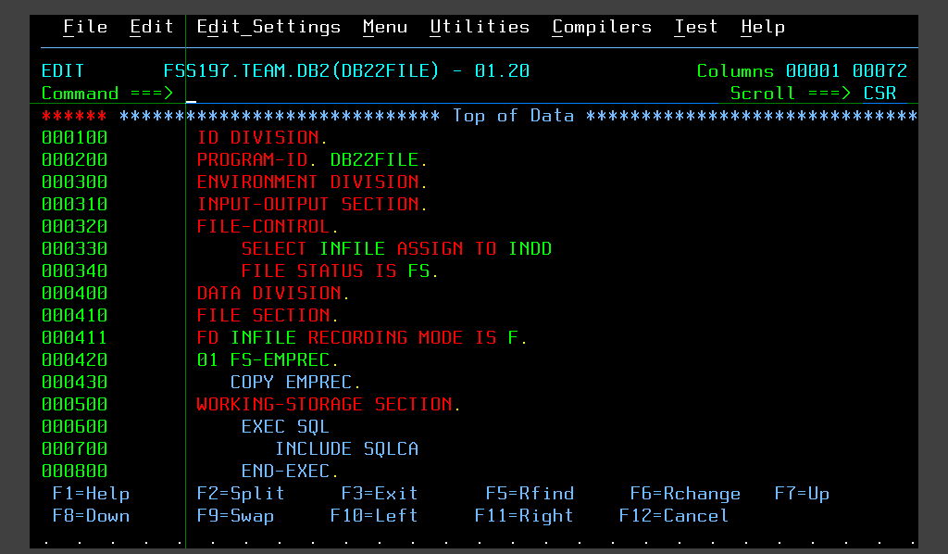
DB2 2 FILE PROGRAM USING CURSOR

Slide 20
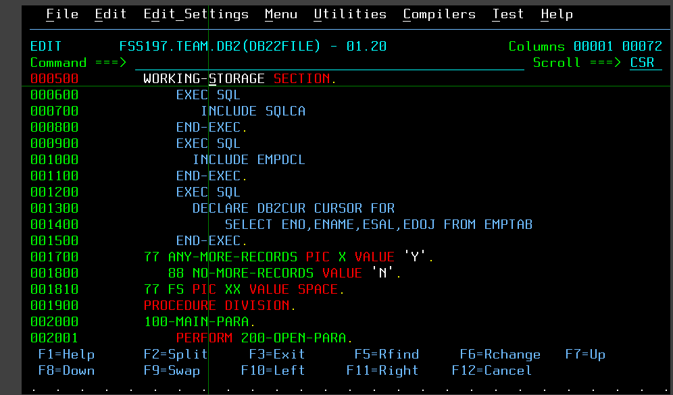
DB2 2 FILE PROGRAM

Slide 21
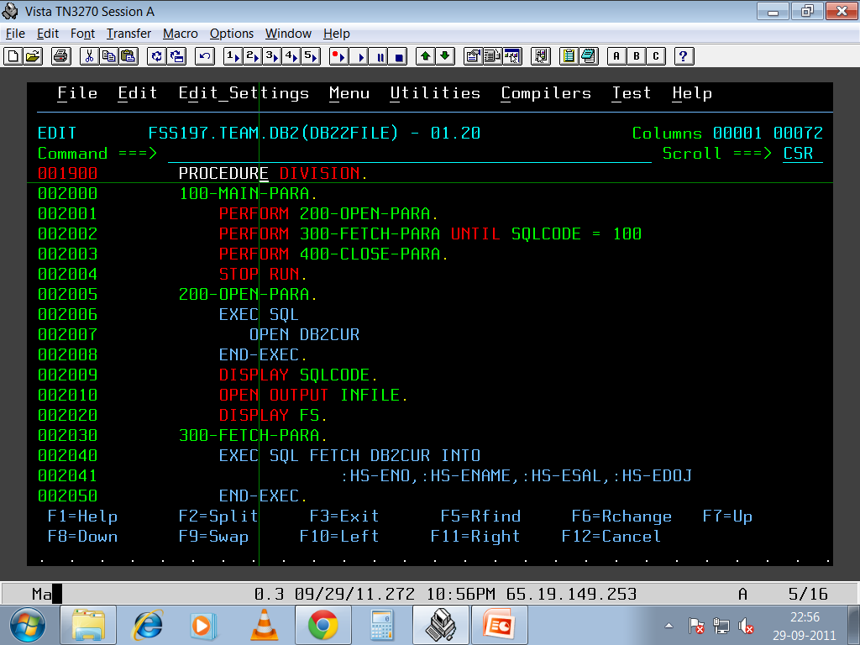
DB2 2 FILE PROGRAM

Slide 22
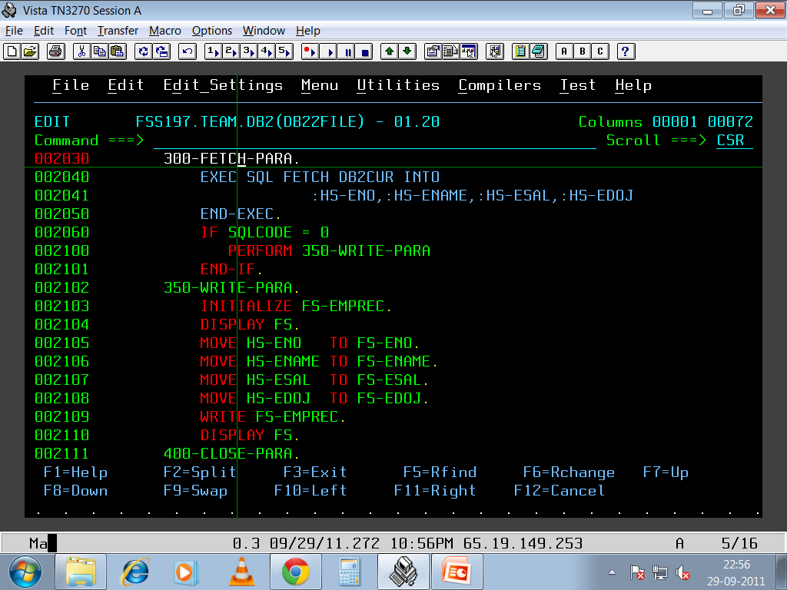
DB2 2 FILE PROGRAM

Slide 23
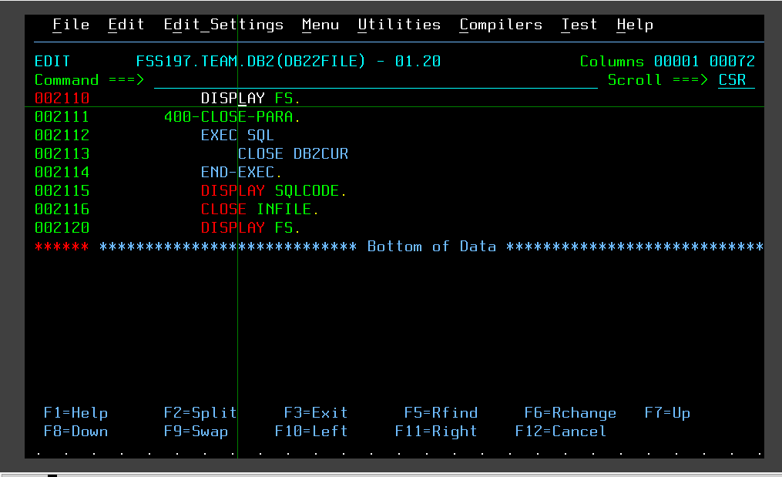
DB2 2 FILE PROGRAM

Slide 24
UPDATE STATEMENT
We can update the data of the current row retrieved by a program by using the UPDATE statement.
Format:
EXEC SQL
UPDATE table-name
SET column-A = value, column-B = value, ...
WHERE CURRENT OF cursor-name
END-EXEC.
Each column to be updated must have been named previously in the FOR UPDATE OF clause of the DECLARE CURSOR statement

Slide 25
The DELETE Statement
We can delete the current row retrieved by a program by using the DELETE statement.
EXEC SQL
DELETE FROM table-name
WHERE CURRENT OF cursor-name
END-EXEC.
After a row has been deleted, you cannot update or delete another row using that cursor until you issue a FETCH statement for the next row.

Slide 26
NULL INDICATOR SQLCODE -305
In DB2 Programs, the columns defined as NULL needs to be handled carefully else it will throw null exception error, in order to over come this error data type can be handled by using null indicator.
Null indicators can hold :
‘-1’ : Field is having NULL value
‘ 0’ : Field is Not NULL value
‘-2’ : Field value is truncated

Slide 27
How To Use Null Indicator
First Declare a null-indicator variable with PICTURE CLAUSE as S9(4) COMP. (Half word binary)
01 WS-NULL-IND PIC S9(4) COMP.
PROCEDURE DIVISION.
EXEC SQL
FETCH CURSOR name INTO :HOST-VAR1,
:HOST-VAR2:WS-NULL-IND,HOST-VAR3…..
END-EXEC.

Slide 28
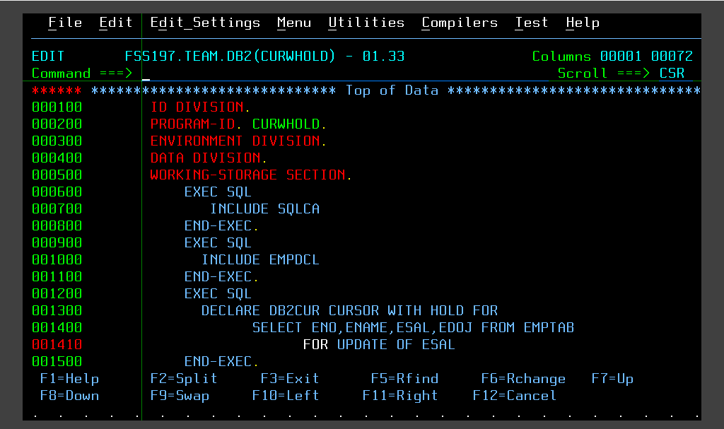
CURSOR WITH HOLD UPDATE

Slide 29
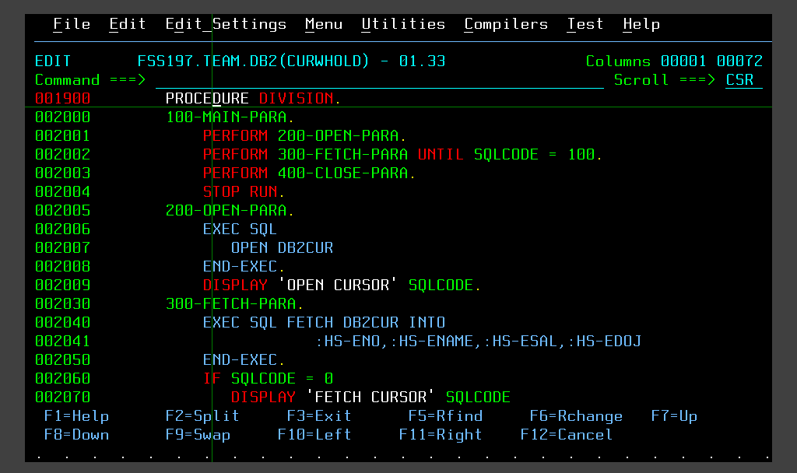
CURSOR WITH HOLD UPDATE

Slide 30
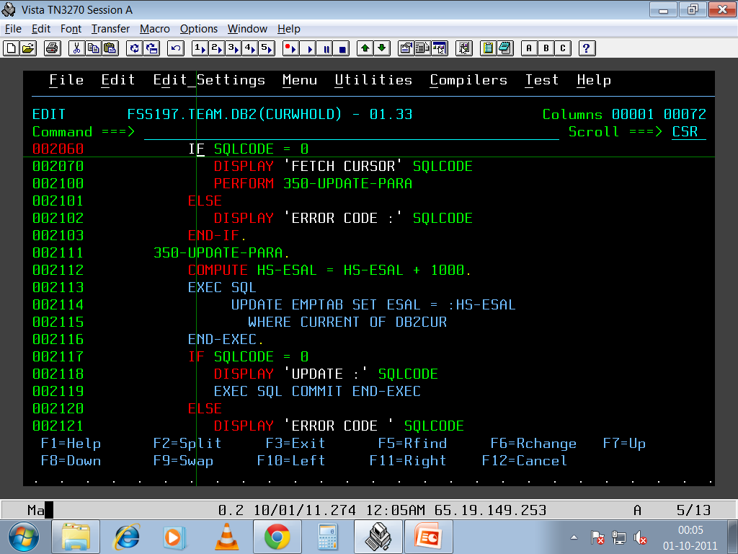
CURSOR WITH HOLD UPDATE

Slide 31
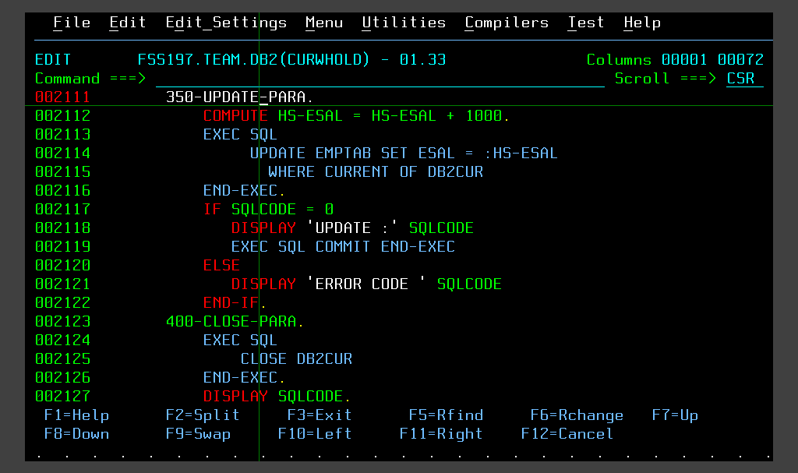
CURSOR WITH HOLD UPDATE

Slide 32
Thank You

